Slide 1
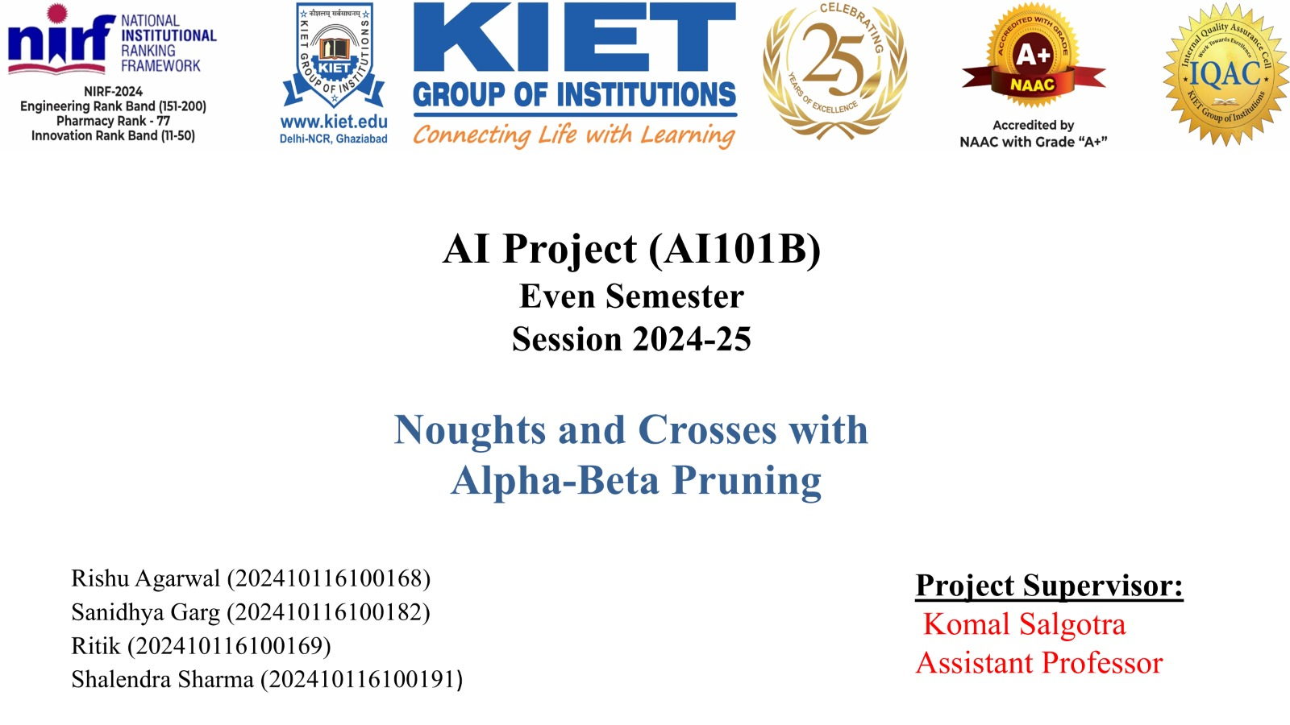

Slide 2
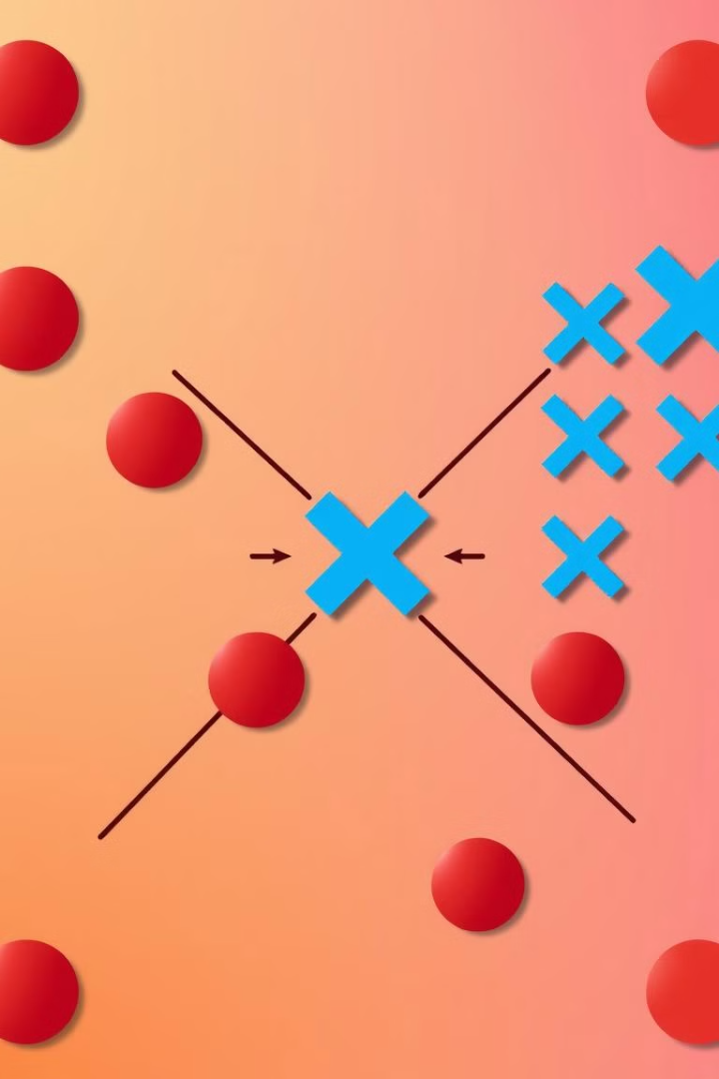
Noughts and Crosses: Winning with Alpha-Beta Pruning.
Noughts and Crosses (Tic-Tac-Toe) is a game where players try to get three marks in a row on a 3x3 grid. Alpha-Beta Pruning is a technique used to speed up decision-making in games by cutting out unnecessary moves. It improves the Minimax Algorithm, which looks ahead at all possible moves. By tracking the best scores for each player, Alpha-Beta Pruning helps find the best move faster.Further Exploration

Slide 3
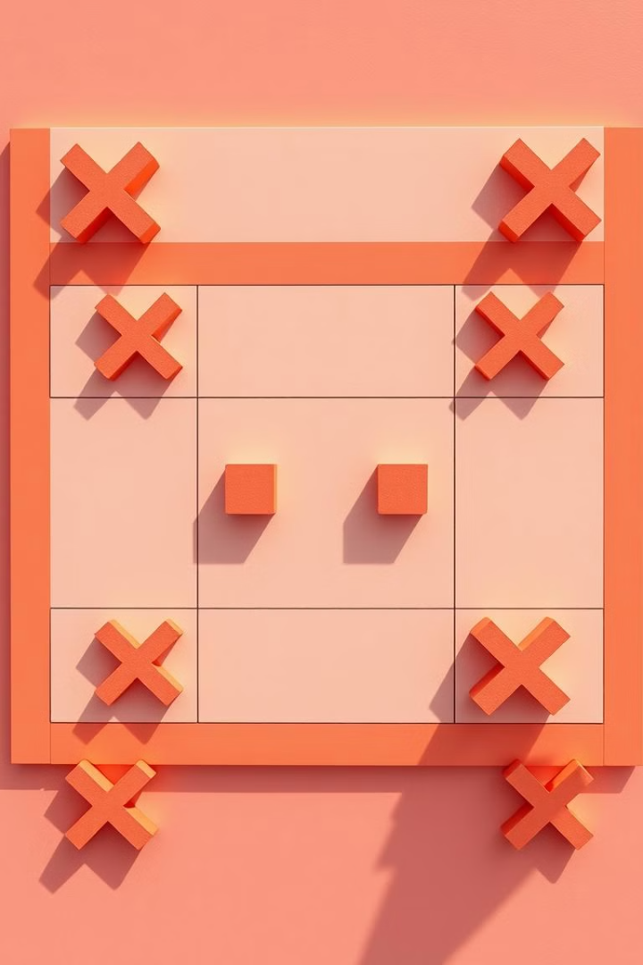
The Game of Noughts and Crosses (Tic-Tac-Toe)
Simple Rules
Objective
Players alternate placing X or O on a 3x3 grid.
The goal is to get three of your marks in a row, either horizontally, vertically, or diagonally.
Perfect Play
If both players play perfectly, the game will always end in a draw, showing a balanced strategy.
Noughts and Crosses, also known as Tic-Tac-Toe, involves simple rules yet offers complex strategies.

Slide 4
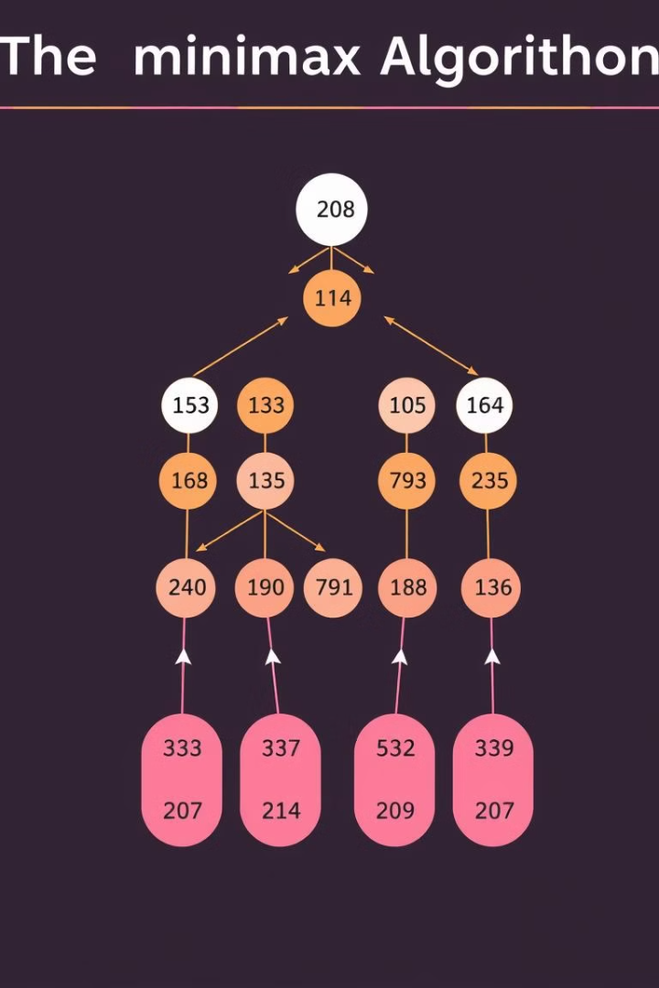
Minimax Algorithm: The Foundation
The Minimax algorithm helps AI make the best decisions in games by looking at all possible moves and their outcomes. It works by choosing the move that leads to the best result, assuming both players play perfectly.
Game Tree
Minimax Principle
Recursive Approach
A branching structure that shows all possible moves in a game.
A strategy to maximize your chances of winning while minimizing risks.
A method that repeatedly evaluates choices to find the best move.

Slide 5

Limitations of Minimax
Exponential Complexity
Computationally Expensive
The time complexity is O(b^d), where b is the branching factor and d is the depth, making it grow rapidly
Requires a lot of processing power for big games.
Poor Scaling
Works well for small games but struggles with complex ones.

Slide 6




Alpha-Beta Pruning: The Optimization
Pruning
Alpha Value
Beta Value
Eliminates branches in the game tree that do not influence the final decision. By cutting off these branches, the algorithm saves time and computational resources.
Tracks the best (highest) score the maximizing player can achieve. It helps decide when to stop exploring less promising moves.
Tracks the best (lowest) score the minimizing player can allow. If a move is worse than beta, the branch is ignored to save time.
Alpha-beta pruning optimizes the Minimax algorithm by eliminating unnecessary branches in the game tree.

Slide 7
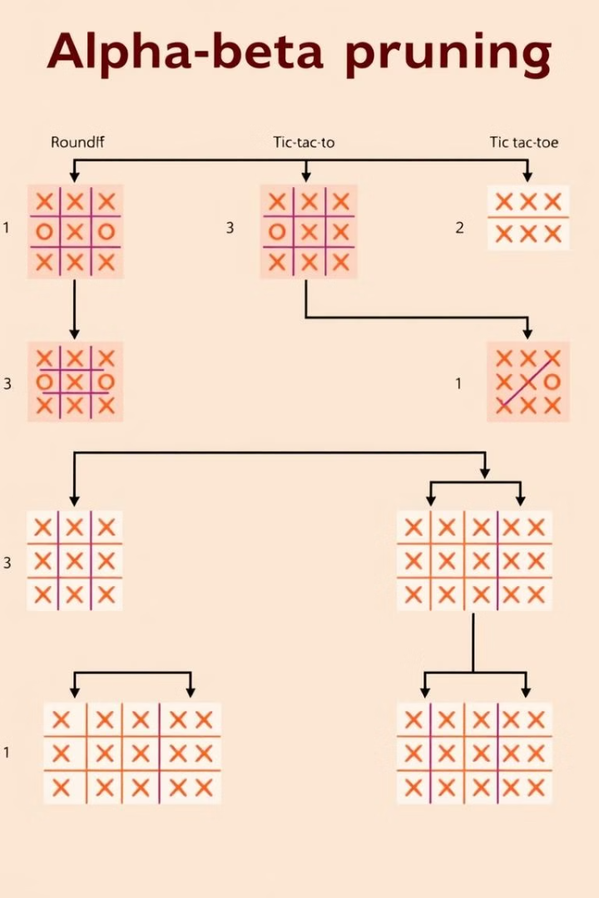
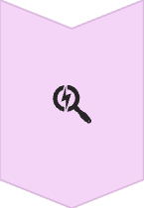
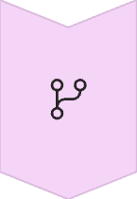
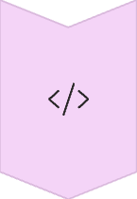
How Alpha-Beta Pruning Works
Search
Adjust alpha and beta values while exploring moves. Stops searching when a branch is no longer useful.
Identify
Finds game tree branches that can be skipped. Pruning reduces unnecessary calculations.
Pseudo-code
Describes the alpha-beta pruning process step by step. Helps in understanding and implementing the algorithm.
By updating alpha and beta values during the search, branches that won't affect the outcome can be identified and pruned.

Slide 8

Benefits of Alpha-Beta Pruning
Reduces search space :
Improves performance :
Eliminates unnecessary branches, making the algorithm faster.
Speeds up decision-making by focusing on relevant moves.
Maintains optimality :
Enables deeper searches :
Finds the best possible move without missing better options.
Allows the algorithm to analyze more moves within the same time.
Alpha-beta pruning offers significant benefits, including reduced search space and improved performance, without sacrificing optimality.

Slide 9
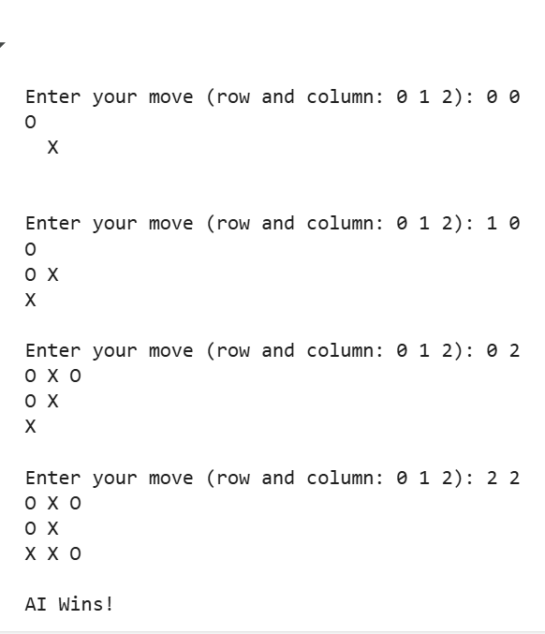
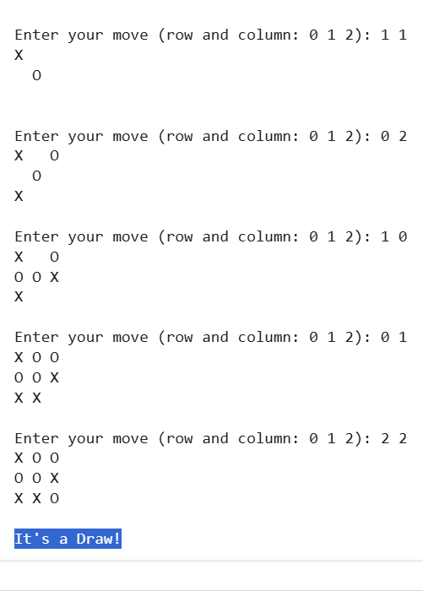
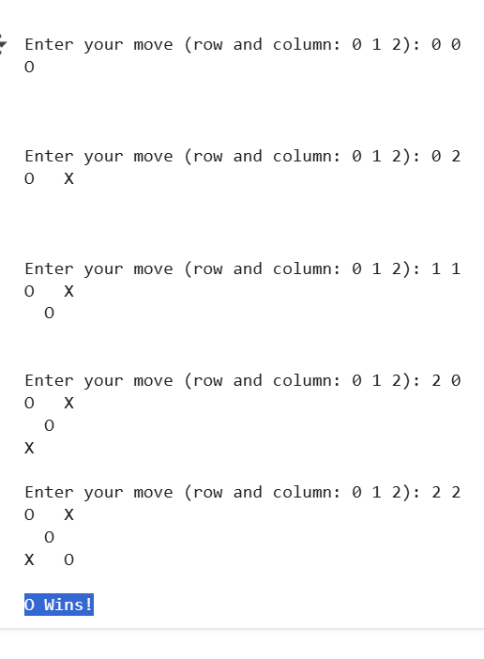
TESTED OUTPUT
1st
2nd
3rd

Slide 10

Conclusion: Alpha-Beta in Action
Powerful Technique
Applicable
Further Exploration
Alpha-beta pruning is a powerful search technique.
It can apply to many game AI problems like Chess, Connect Four, Custom Board Games.
Consider Monte Carlo Tree Search and Deep Reinforcement Learning.
Alpha-beta pruning is a versatile tool applicable to various game AI challenges. Consider exploring advanced techniques for further optimization.

